Slide 1

ReSpicy - System Design
A Recipe & Meal Planning Platform
By: James McGuigan & Steven Forester

Slide 2
Introduction
Recspicy is a web-based platform for recipe discovery and meal planning.
Integrates API-based and user-generated content.
Designed for home cooks and food enthusiasts.

Slide 3



Problem Statement
• EXISTING PLATFORMS LACK MEAL PLANNING AND ADVANCED SEARCH FEATURES.
• USERS STRUGGLE WITH DISORGANIZED SEARCHES AND DIETARY FILTERING.
• RECSPICY FILLS THESE GAPS WITH STRUCTURED PLANNING AND DISCOVERY.

Slide 4
Assumptions, Constraints, and Risks
Assumptions: Users want an organized way to find and save recipes.
Constraints: Responsive design, API rate limits, security measures.
Risks: Data privacy concerns, API dependency, system performance issues.

Slide 5
System Overview
• Built using the MERN stack:
- Frontend: React.js, HTML, CSS
- Backend: Node.js, Express
- Database: MongoDB
- Authentication: JWT
- External API: Tasty API for recipes

Slide 6
SQL
NoSQL
Relational
Not Relational
The tables are related.
Thee data certainly exists
Tables
Collections
The layout and content is defined
We put the documents together
Data
Documents
Fits its slot, or you have issues
These hold data
Schema
Freedom
The bedrock of any SQL Database
There are no schemas, unless you want them, for MongoDB this means Mongoose.
Team 1
Page #

Slide 7
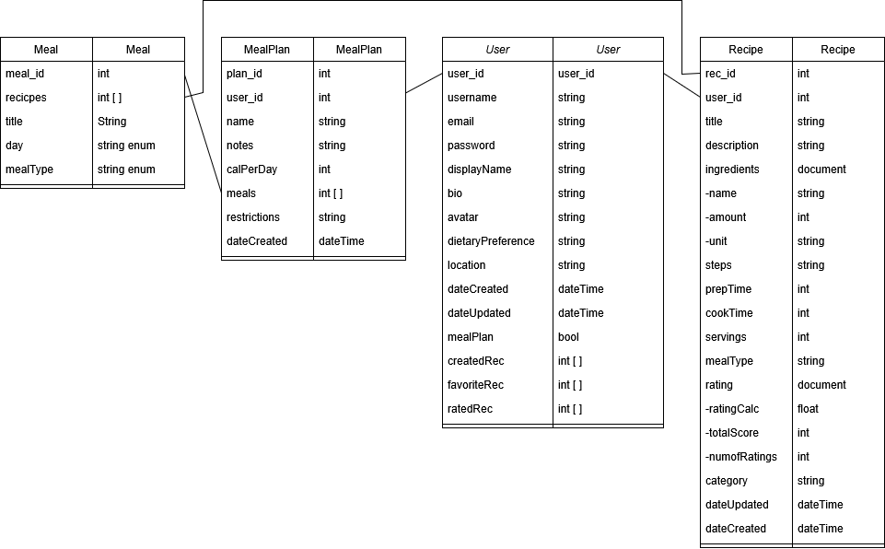
Database Model

Slide 8
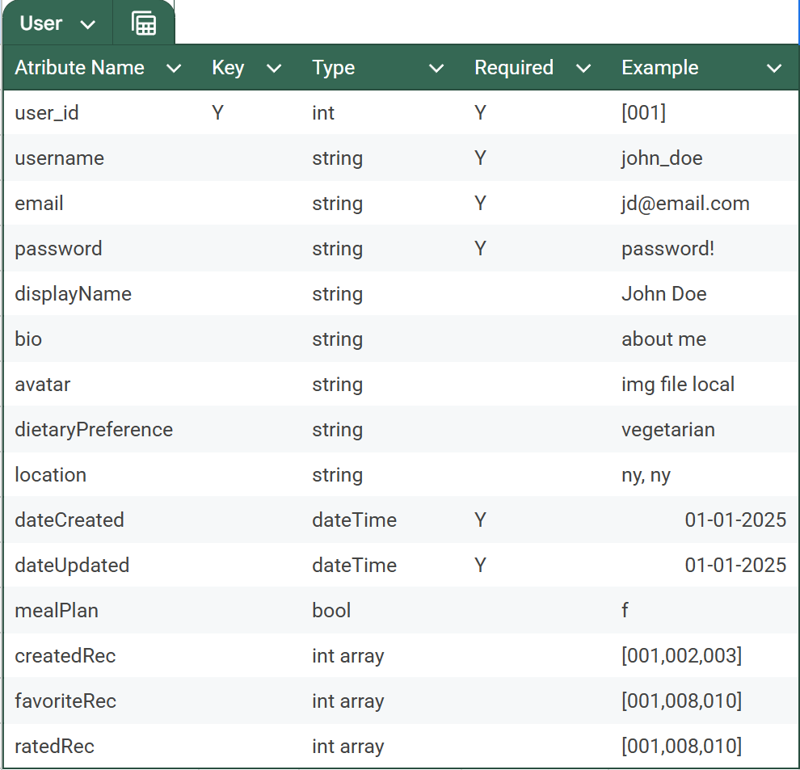
User Model

Slide 9
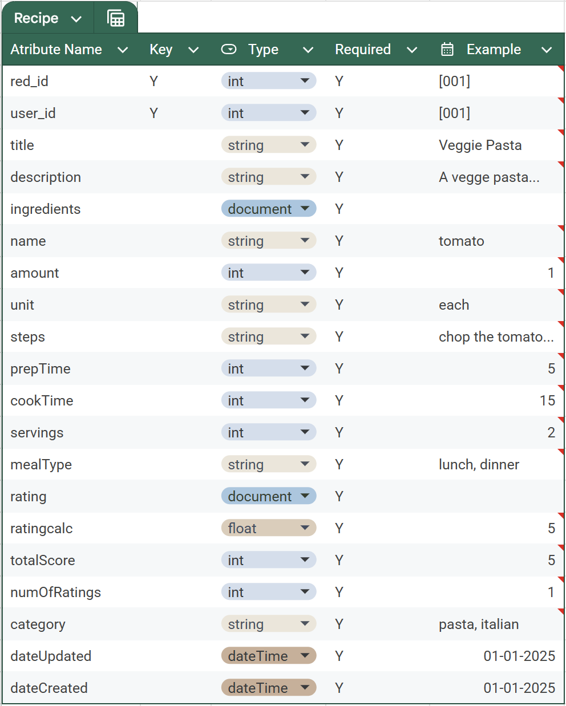
Recipe Model

Slide 10
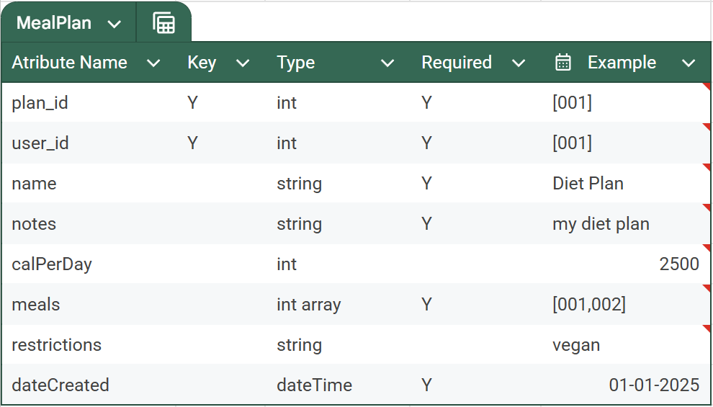
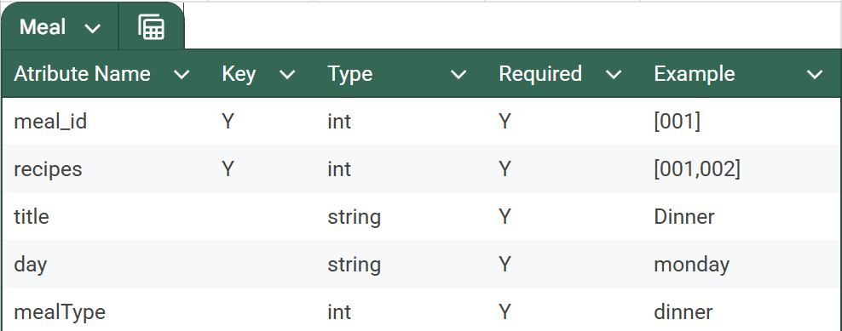
Meal Plan Model

Slide 11
User Interface
Navigation includes:
- Home
- Recipe Discovery
- Meal Planning
- User Profile
- Recipe Creation

Slide 12
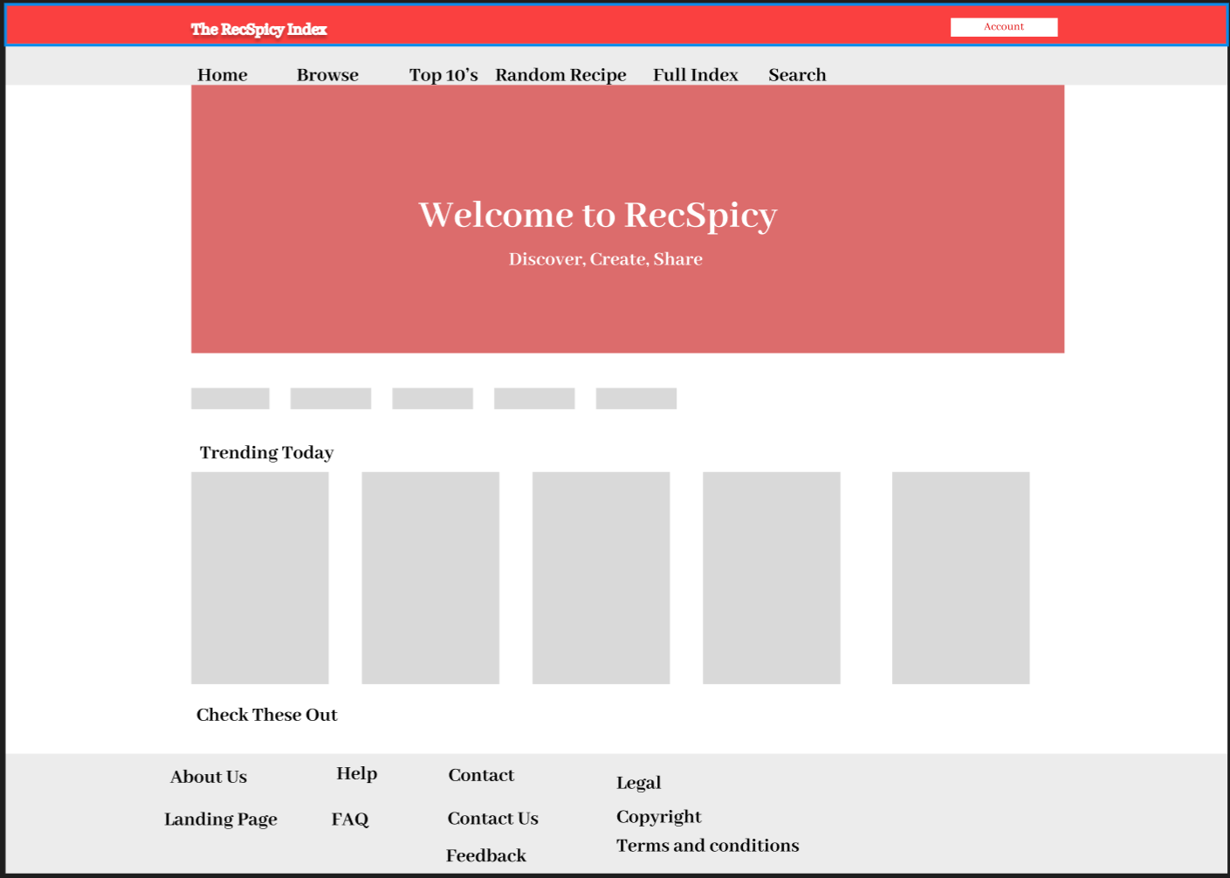
Wireframe - Home Page

Slide 13
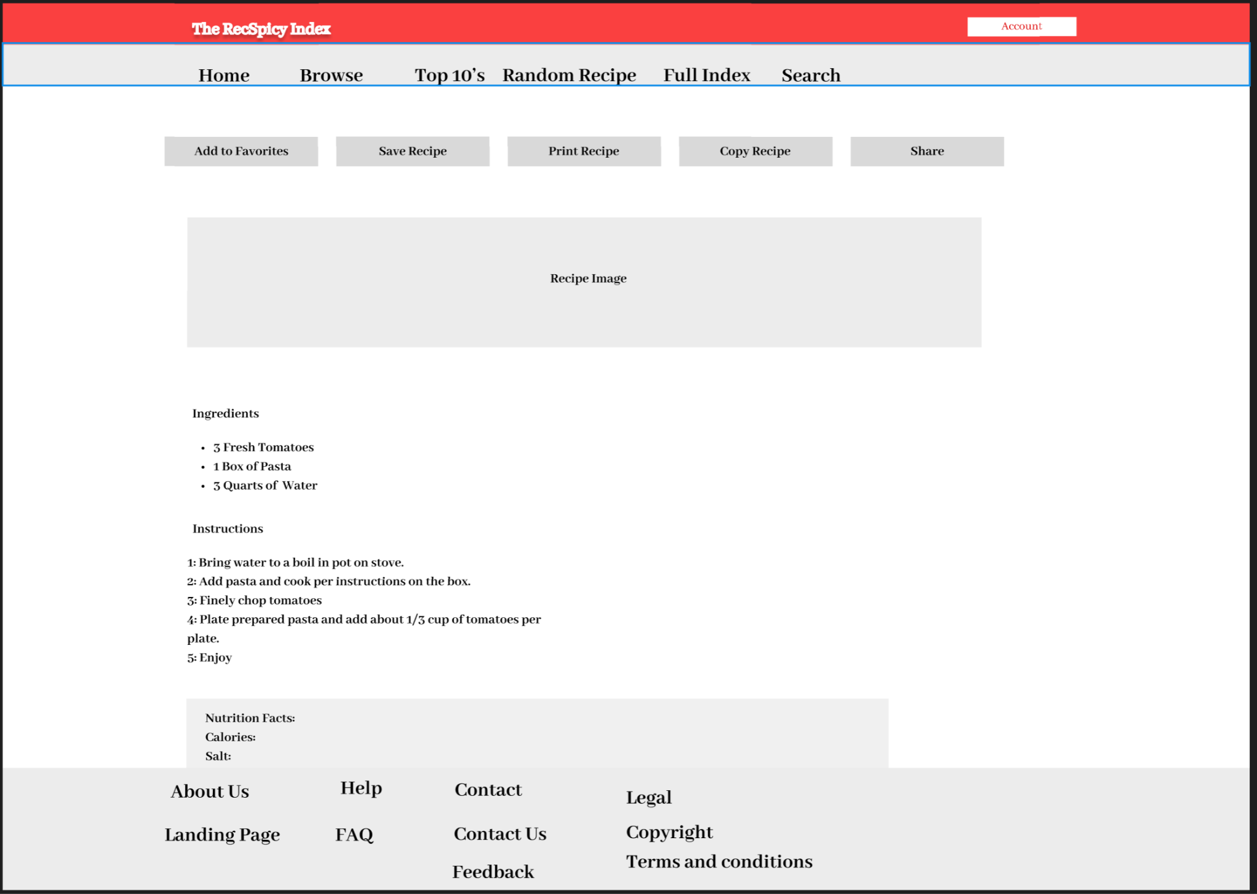
Wireframe - Recipe Detail Page

Slide 14
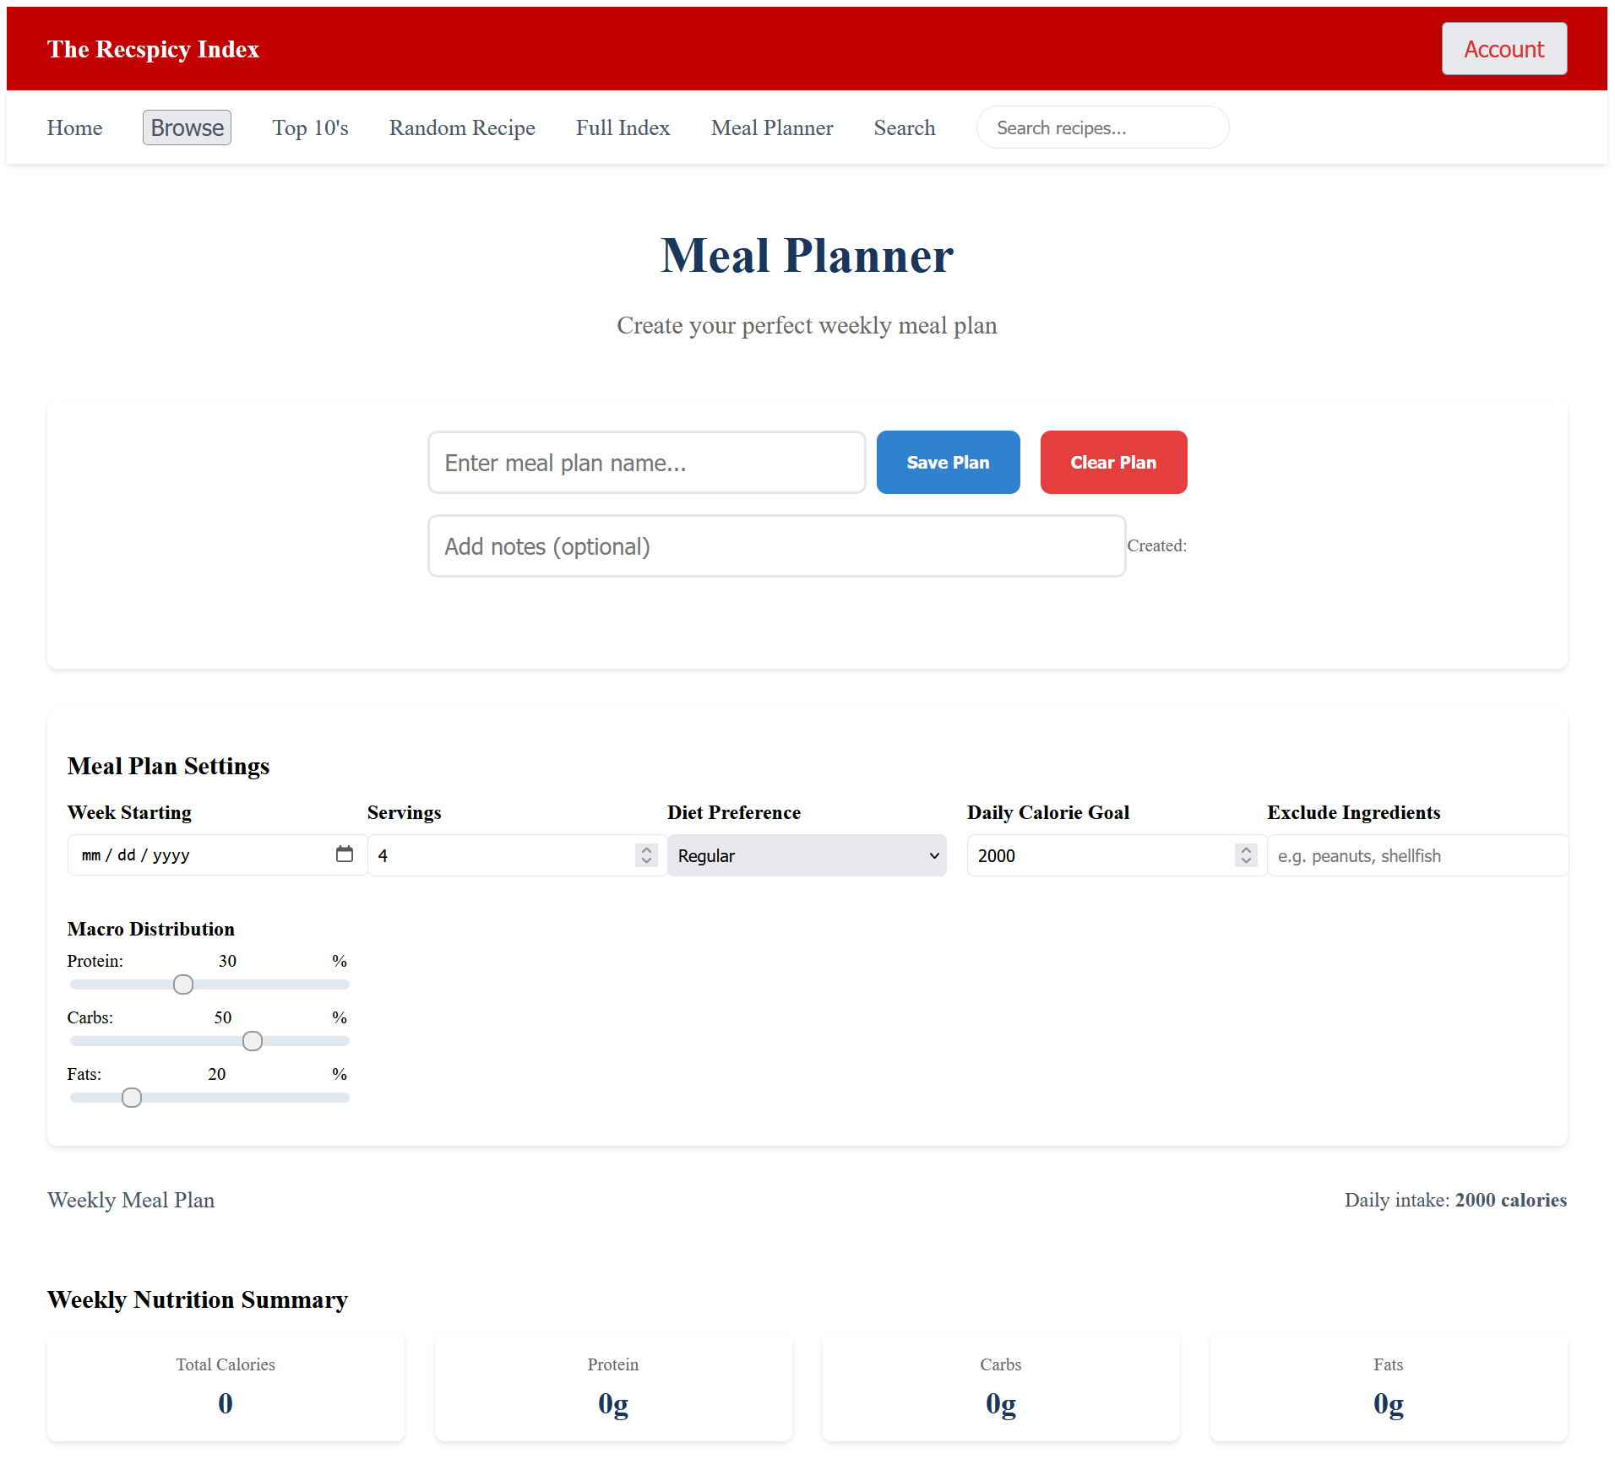
Wireframe - Meal Planning Interface

Slide 15




API Development
• RESTful APIs handle authentication, recipe management, and meal planning.
• External integrations:
- Tasty API for recipes
- Nutrition API for calorie tracking.

Slide 16



Search Engine & Filtering
• Search by title, ingredient, dietary preference, or cooking time.
• Advanced filtering options improve search results.
• Full-text indexing speeds up search performance.

Slide 17
Meal Planning System
• Users create structured meal plans with integrated nutritional tracking.
• Features include:
- Auto-suggested meals
- Shopping list generation
- Portion adjustments.

Slide 18



Admin Controls & Moderation
• Admins review flagged content, handle reports, and manage users.
• Analytics track recipe popularity and engagement.
• System monitoring ensures stability and security.

Slide 19

Appendix & References
System Diagrams – Includes database schema, API structure, and data flow charts.
Wireframes & UI Mockups – Displays layout concepts for core pages like Home, Recipe Detail, and Meal Planning.
Use Case Scenarios – Provides examples of how users interact with the platform.
Data Models – Shows structured representations of users, recipes, meal plans, and favorites.
API –Third-party APIs Tasty API and Nutrition API.
Security Standards – Guidelines for JWT authentication, password hashing, and data encryption.
Performance Optimization Techniques – Resources on caching, query indexing, and load balancing.
Web Accessibility Guidelines –Compliance with usability standards for all users.
Development Frameworks & Libraries –Node.js, Express, and MongoDB.

